Slide 1


In pursuit of the ‘Holy Grail’: Determining the Return on Workplace Investment (ROWI)
12pm, Wednesday 17 November 2021

Slide 2
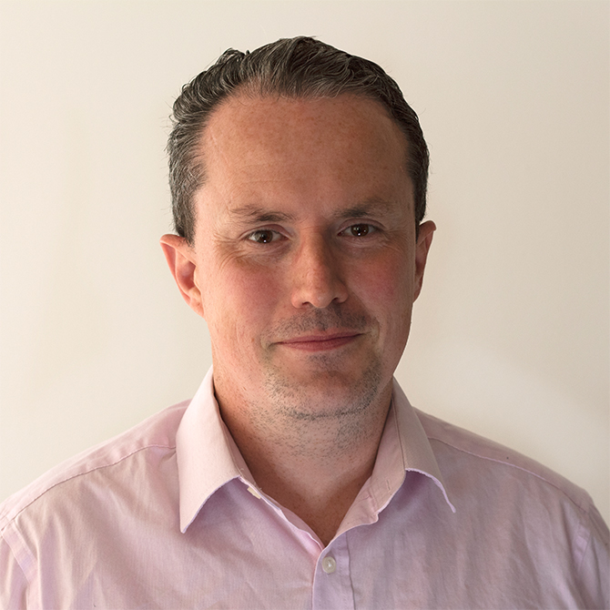
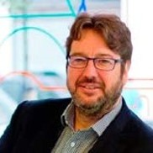
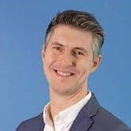
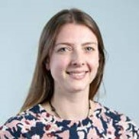
Panellists
Host
Peter Brogan,
Head of Research and Insight, IWFM
Dr Nigel Oseland: Workplace Strategist, Workplace Unlimited
Matthew Tucker: Reader in Workplace and FM, Liverpool Business School
Dr Hannah Wilson: Senior Lecturer, School of Doctural Management Studies
Notes:
Dave Cooke
Dave Cooke is an independent consultant specialising in resilience, business continuity and crisis management and he chairs the IWFM Risk and Business Continuity SIG.
Dave spent over 30 years working for the BBC’s International News Division and headed their Facilities Management function before specialising in security, business continuity and risk management. He was head of Business Continuity and Risk Management for BBC Global news with responsibilities for maintaining staff safety and programme output in their multi-media news operations in the UK and 90 countries around the world.
More recently Dave has been working with clients across industry sectors to help them responded effectively to the Coronavirus pandemic and adapt their continuity plans to meet the current challenges.
Dave is a Fellow of the IWFM, a member of the Business Continuity Institute and holds Board certifications in Business Continuity and Security. Dave is also a member of the British Standard Institute’s Continuity and Resilience Committee and Board member of the UK Security Commonwealth.
Jon Newson
Jon has worked both in the UK and internationally, as a change manager, bringing about smooth transitions through effective communication and stakeholder engagement for facilities organisations. As deputy chair of the IWFM Risk Management and Business Continuity Special Interest Group, he co-authored the new IWFM Good Practice Guide for Risk Management. Jon’s client list over his 25 years facilities experience includes Macro, RBS, HMRC, EY, Sainsburys, 2012 CLM, Emaar (Dubai) and Digiplex (Scandinavia).
Jon recently worked with Oxfordshire County Council to successfully recover and redesign a facilities engineering and maintenance service, changing from an outsourced model to a self-delivery organisation, on the collapse of Carillion. Recruiting, building processes and delivering transition within a two-week time frame to support business continuity for Oxfordshire County Council services, including implementation of a CAFM system as a reactive service initially within two days.
Currently he is applying his experience and thinking to the effects of the covid-19 pandemic and the challenges facing organisations, including the recovery phase.
Sofie Hooper
Sofie leads on the IWFM’s wider policy and public affairs work, helping to raise the voice of the Institute, its members and the wider workplace and facilities management sector. She translates best practice into policy objectives and engages with stakeholders to ensure best practice is taken on board and any concerns affecting workplace and facilities professionals are mitigated.

Slide 3
Agenda
Welcome and introductions
Background and context
Tool development
ROWI tool demonstration
Discussion and questions
Final thoughts and close

Slide 4
Welcome and introductions

Slide 5
Background and context

Slide 6
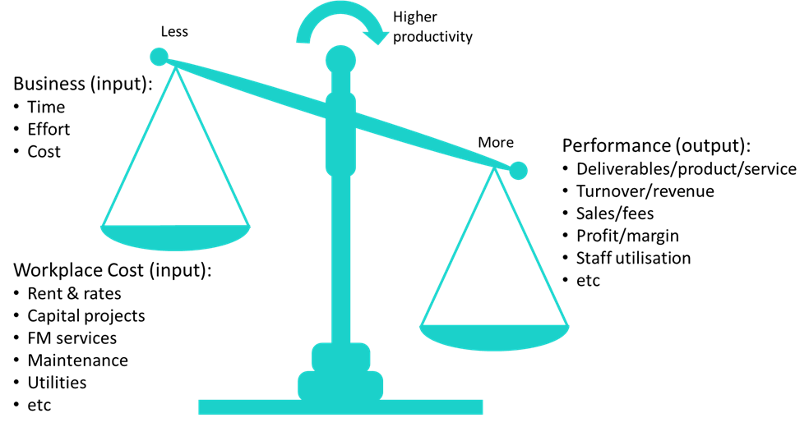
The productivity puzzle
Notes:
Oseland and Burton (2012) developed a methodology to help predict the potential gain in worker productivity that can be expected following workplace design improvements. Focused on environmental factors (i.e. independent variables)
As such, there is no tangible tool to assist workplace professionals in making major decisions regarding changes to their workplace environment, using independent and dependent variables

Slide 7

Tool development

Slide 8
Tool development
Workplace OR building OR office AND productivity OR strategy AND measure
ProQuest
6,322
Web of Science
1,822
Science Direct
731
Business Source Complete
421
9,356
Workplace OR building OR office AND productivity OR strategy AND measure
AND NOT engineering OR energy OR Microsoft OR strategy OR lifecycle
ProQuest
1,016
Web of Science
870
Science Direct
425
Business Source Complete
237
2,548

Slide 9
Tool development
Database | Overall | C-list | B-list | A-list
ProQuest | 1,016 | 956 | 46 | 14
Web of Science | 870 | 795 | 58 | 17
Science Direct | 425 | 407 | 14 | 4
Business Source Complete | 237 | 219 | 11 | 7
Total | 2,548 | 2,377 | 129 | 42

Slide 10
Tool development
A-list electronic database articles
42
Hand-searched priority journals and specific sub-themes
46
Sources obtained from existing networks and organisations
17
References imported in EndNote
105
Duplications identified and removed
17
Final references included for analysis
88

Slide 11
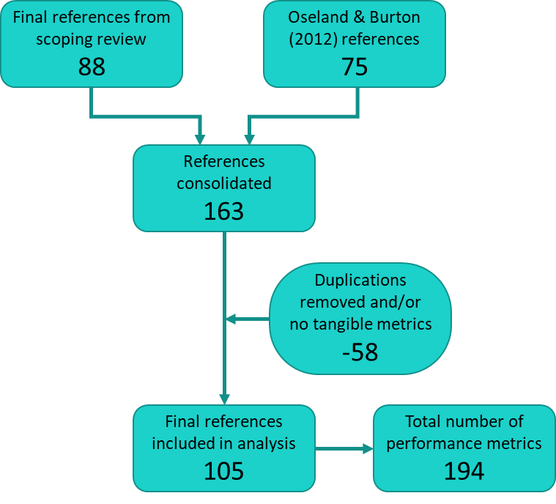
Tool development

Slide 12
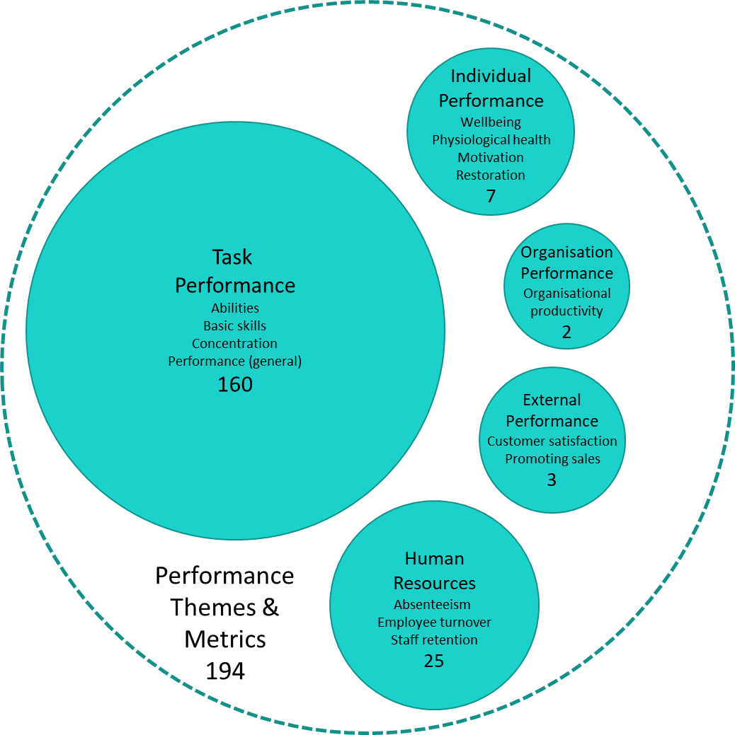
Performance metrics

Slide 13
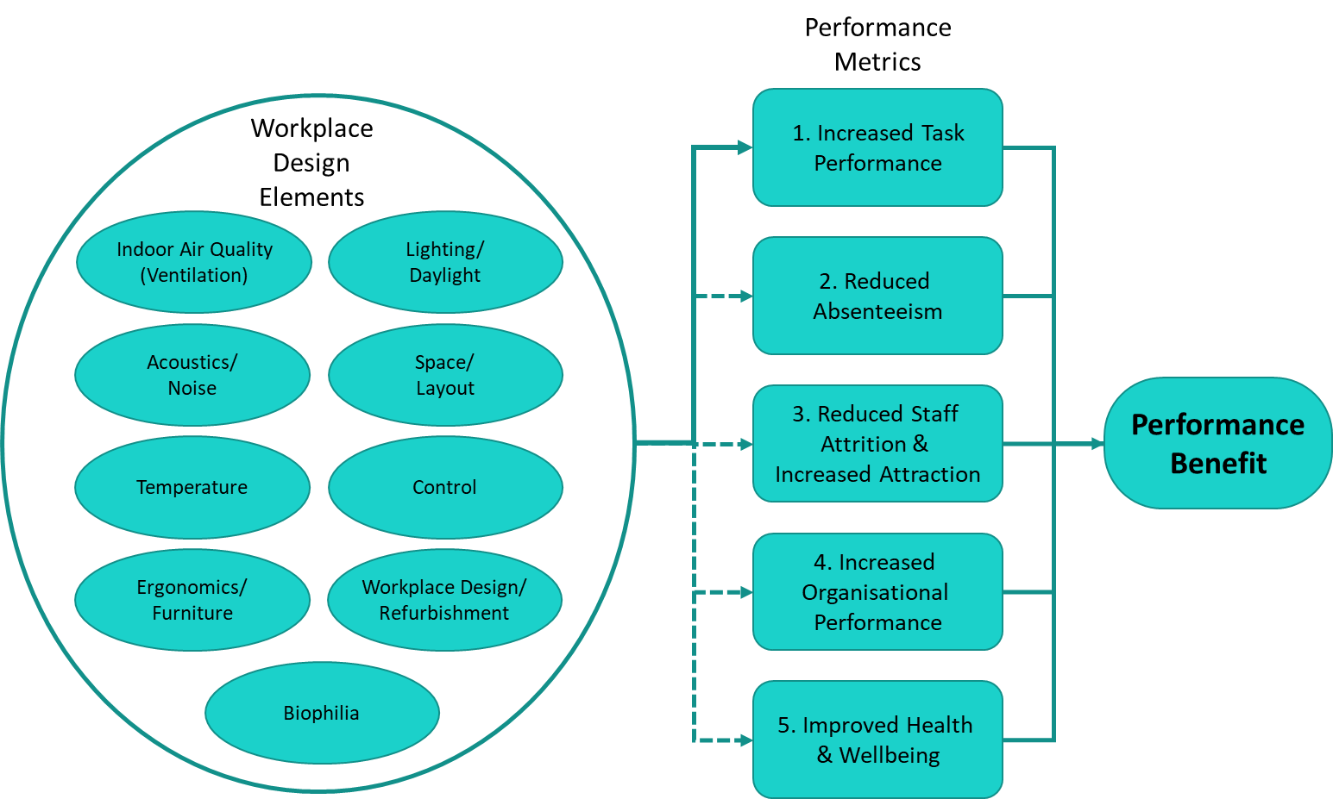
Tool variables

Slide 14
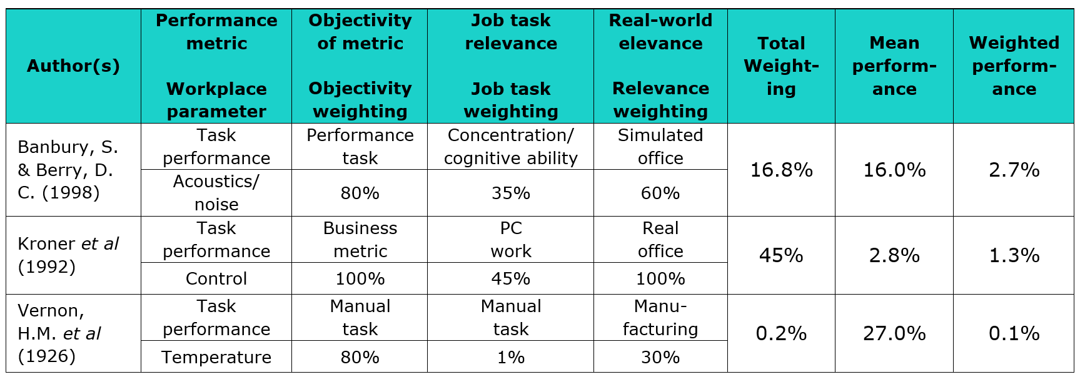
Performance weightings

Slide 15
Key variables
Confidence
Medium Low High

Slide 16
Key variables
Confidence
Medium Low High
Task
Performance

Slide 17
ROWI Tool Demonstration

Slide 18
Tool input/output
1
Costs
2
Org
3
Input
4
Output

Slide 19
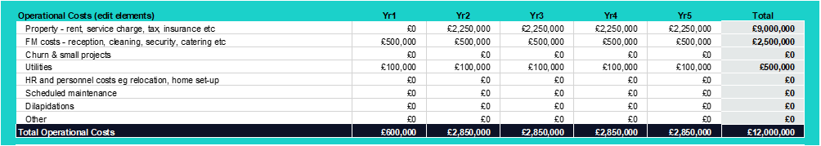
Capital & operational costs

Slide 20
Organisational variables

Slide 21
Benefits input

Slide 22
Benefits output

Slide 23
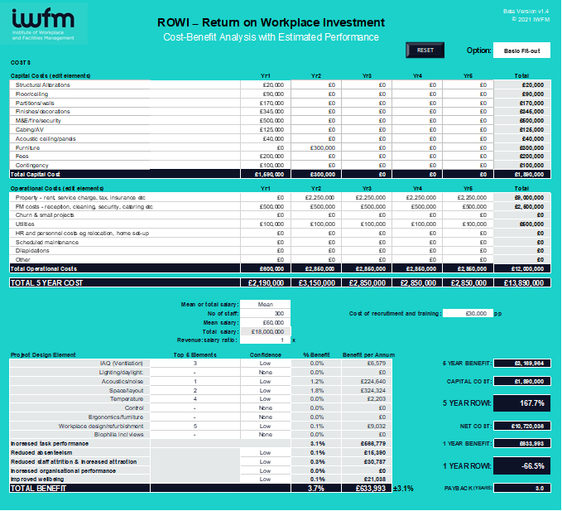
Completed example

Slide 24
Multiple spreadsheets/options

Slide 25


Your questions

Slide 26
If you are interested in getting involved in the pilot, please email research@iwfm.org.uk

Slide 27

Continue the ROWI conversation on LinkedIn
IWFM
#workplace #futureofwork #ROWI

Slide 28
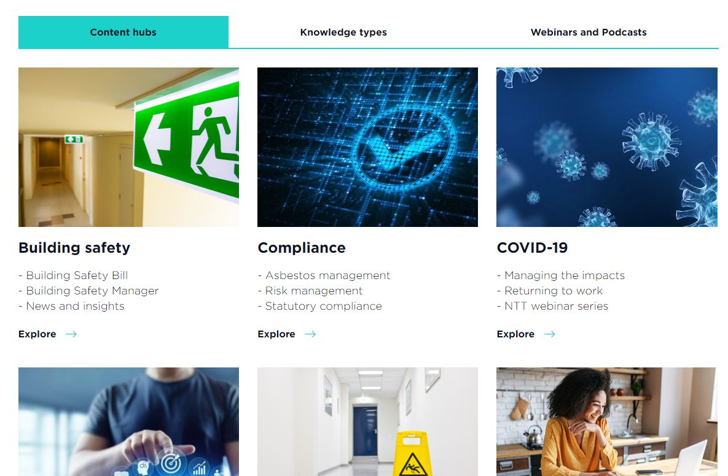

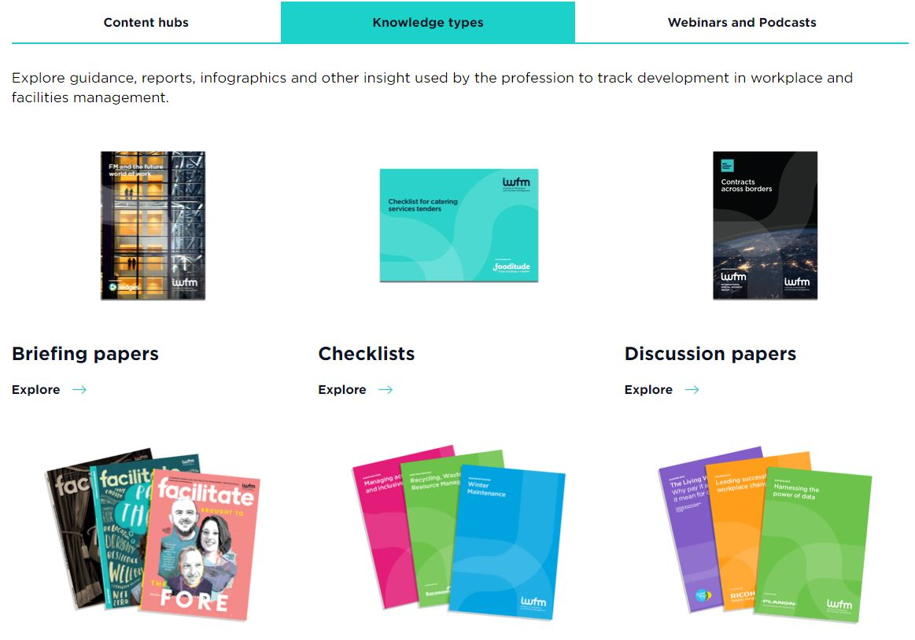

Insight hub
Dedicated content hubs
Research reports
Good practice guides
Guidance notes
And more…
Available to download at iwfm.org.uk/insight

Slide 29

iwfm.org.uk/coronavirus-resources.html

